Slide 1
Disease of digestive System (upper part)
By
Assistant Proof. Methaq A .Abdalsammad

Slide 2
ORAL CAVITY - GENERAL
The oral cavity is easily examined during clinical and postmortem examinations. A thorough examination of all structures will reveal not only local lesions but often those which may be due to systemic disease.
Icterus – The oral mucous membranes and gingiva appear yellow.
Anemia – The mucous membranes appear pale.
Cyanosis - A gray tinge to the mucosa is an indicator of inadequate oxygenation and may be a reflection of cardiovascular disease.
Uremia - Ulcers on the epithelium adjacent to the salivary duct openings are an indication of uremia.

Slide 4
Inflammation of the oral cavity
The general word for inflammation of the oral cavity is stomatitis. Inflammatory processes may be localized to specific tissue and given specific names See the list below.
lips – cheilitis
pharynx – pharyngitis
tongue – glossitis
gums – gingivitis
tonsils – tonsillitis
Types of stomatitis:
A). Infectious stomatitis:
1). Thrush, or oral candidiasis:It is amycotic infection occuerred due to infection with cacdida albicans which consider normal flora of oral cavity, If the balance becomes altered, the endogenous flora may take advantage of the situation and proliferate to cause disease. It is a common indicator of severe immunosuppression and may be associated with severe stress.

Slide 5
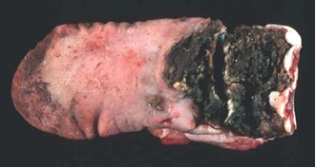
2). Wooden tongue: - Caused by Actinobacillus lignieresii, it is a granulomatous reaction in the deep tissues of the tongue, in cattle. This organism is part of the normal oral flora; when the defenses are disrupted, such as might happen with a penetrating wound, the organism is allowed access to deeper structures, and incites this granulomatous reaction.
The tissue becomes very firm, so much so that the common name for this disease is "wooden tongue." Sometimes yellow granules are seen grossly in this inflammation - these are called "sulfur granules", are very characteristic, and consist of individual inflammatory foci with abundant bacteria
Wooden toungue,toungue become so firm with the presence of sulfur granules

Slide 7
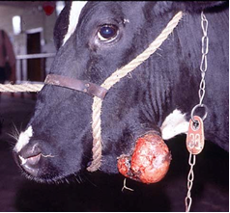

Slide 11
Megaesophagus :it means dilatation of the esophagus, Megaesophagus may be due to a congenital defect or may be an adult-onset, acquired disorder,in both the muscles of esophagus fail to force food into the stomach, The frequency of regurgitation occurred, Regurgitation associated with megaesophagus occurs several minutes to several hours after feeding

Slide 12
CHOKE
The lodging of foreign bodies in the esophagus, a.k.a. “choke,” is a notorious cause of esophageal obstruction in cattle and horses. Both cattle and horses have a tendency to try to swallow items larger than they should. When these objects become lodged in the esophagus, obstruction results. In cattle, this can be an emergency, because if cattle can't eructate and release gas from their rumen, they bloat and bloat is life threatening.

Slide 13
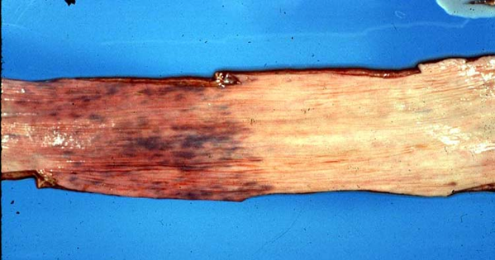
The pathognomonic lesion of bloat is a "bloat line" that occurs at the thoracic inlet in cattle that bloat. It’s not really a line, but rather a border. The increased thoracic pressure from the rumenal distention results in esophageal ischemia (in the thoracic part), while the esophagus in the neck region is normal or congested. So, there is a line at the thoracic inlet, separating congested from ischemic tissues.
A
B
Bloat line; separating ischemic tissues (A) from congested or normal tissues (B)

Slide 14
A complication of choke occurs when the stuck object presses against the esophagus hard enough to cause segmental necrosis. This leads to ulceration. And, if the necrosis is severe enough, scarring occurs and there is a stricture left. These strictures can hinder an animal's production for the rest of its life. Another sequela to having a foreign body in the esophagus is that a diverticulum will form, that is, the foreign body will push hard enough on the mucosa that it herniates through the muscularis and develop a fibrous wall surrounding it. This is better than the alternative which is that the foreign body pushes through the esophagus so that the esophagus perforates completely (esophageal fistula) and the foreign body ends up in the adventitia and can incite a tremendous cellulitis and, if within the thorax, severe thoracic inflammation

Slide 15
Thanks for you

